Slide 1

6th Grade Accelerated Math
Unit 11, Lesson 5 Solving Real-World Problems with Rational Numbers – Part 1 Volume 2, pg. 184

Slide 2


Benchmark
MA.7.NSO.2.3
Solve real-world problems involving any of the four operations with rational numbers.
volume 2, pg. 184

Slide 3
Integrated Mathematical Thinking and Reasoning Standards
MA.K12.MTR.1.1 Actively participate in effortful learning both individually and collectively.
MA.K12.MTR.3.1 Complete tasks with mathematical fluency.
MA.K12.MTR.4.1 Engage in discussions that reflect on the mathematical thinking of self and others.
MA.K12.MTR.5.1 Use patterns and structure to help understand and connect mathematical concepts.
MA.K12.MTR.7.1 Apply mathematics to real-world contexts.
volume 2, pg. 184

Slide 4

Learning Target
I can solve problems with one or two operations by adding, subtracting, multiplying, and/or dividing rational numbers.
volume 2, pg. 184

Slide 5

Warm-Up
volume 2, pg. 185

Slide 6
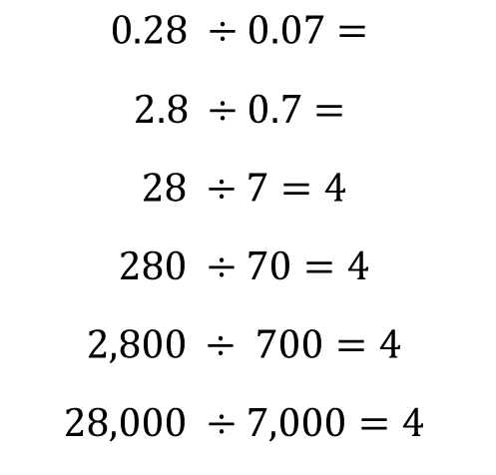
11.5.1 Warm-Up: Notice and Wonder
Several division equations are shown.
$$0.28 ÷0.07=$$
$$2.8 ÷0.7=$$
$$28 ÷7=4$$
$$280 ÷70=4$$
$$2,800 ÷ 700=4$$
$$28,000 ÷7,000=4$$
volume 2, pg. 185

Slide 7
What do you wonder about the pattern?
What do you notice about the equations?
Use the pattern in the equations to determine the quotients of the first two equations.
volume 2, pg. 185

Slide 8

Collaboration
volume 2, pg. 185

Slide 9

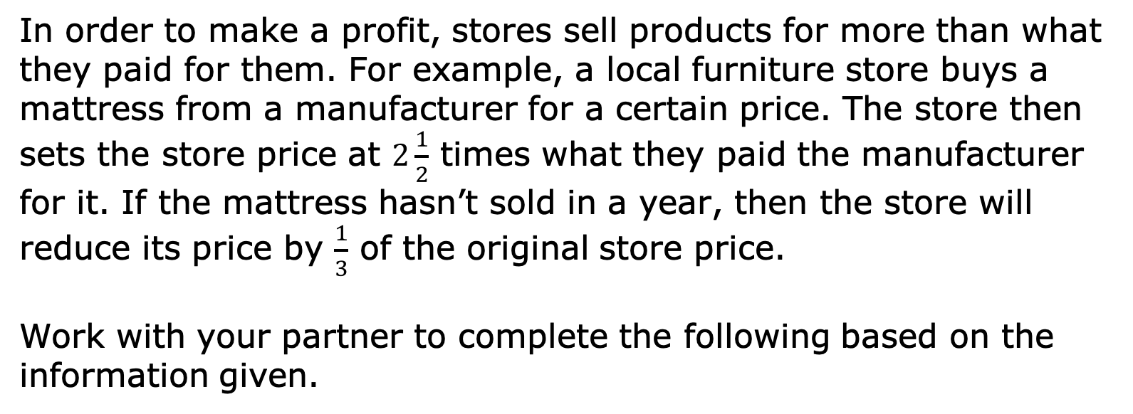
11.5.2 Collaboration: Solving a Problem with Rational Numbers
In order to make a profit, stores sell products for more than what they paid for them. For example, a local furniture store buys a mattress from a manufacturer for a certain price. The store then sets the store price at $2\frac{1}{2}$ times what they paid the manufacturer for it. If the mattress hasn’t sold in a year, then the store will reduce its price by $\frac{1}{3}$ of the original store price.
Work with your partner to complete the following based on the information given.
volume 2, pg. 185

Slide 10
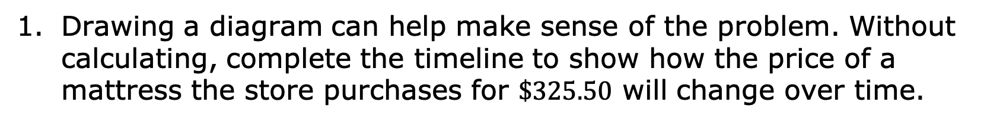
Drawing a diagram can help make sense of the problem. Without calculating, complete the timeline to show how the price of a mattress the store purchases for $\$325.50$ will change over time.
Store buys mattress
Event
Store sets store price
1 year
Description of the Price
volume 2, pg. 185

Slide 11
Explain whether the store’s first price will be greater than or less than the price they paid the manufacturer.
What is the first price the store will set for the mattress?
Explain whether the price after a year will be greater than or less than the store’s first price.
volume 2, pg. 186

Slide 12
What is the sale price of the mattress after one year?
If the store sells the mattress after one year, explain if the store will make or lose money on the mattress.
volume 2, pg. 186

Slide 13

Guided Instruction
volume 2, pg. 186

Slide 14
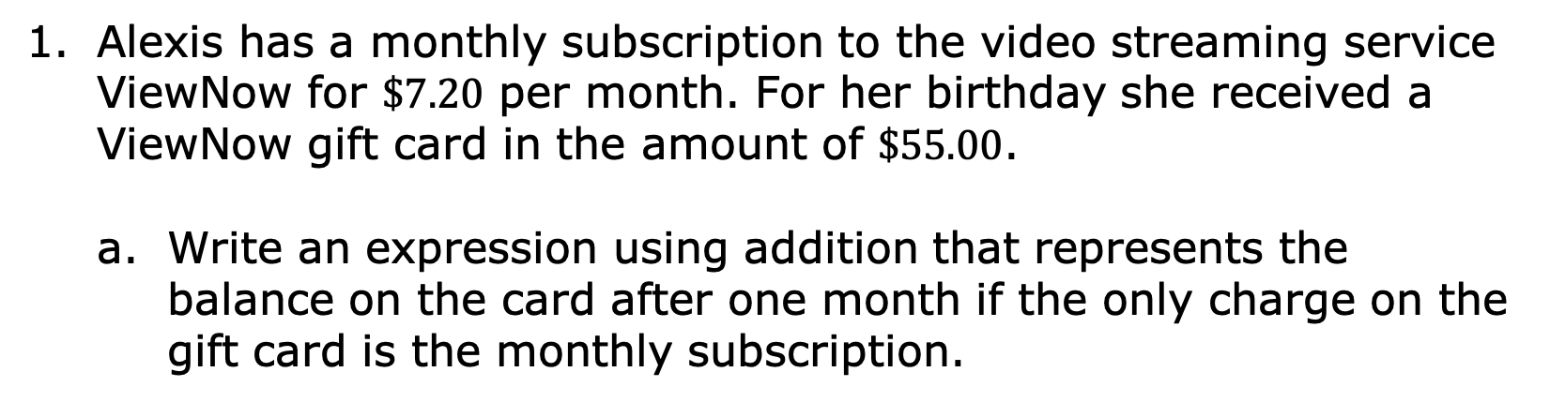
11.5.3 Guided Instruction: Solving Real-World Problems with Rational Numbers
Alexis has a monthly subscription to the video streaming service ViewNow for $\$7.20$ per month. For her birthday she received a ViewNow gift card in the amount of $\$55.00$.
Write an expression using addition that represents the balance on the card after one month if the only charge on the gift card is the monthly subscription.
volume 2, pg. 186

Slide 15
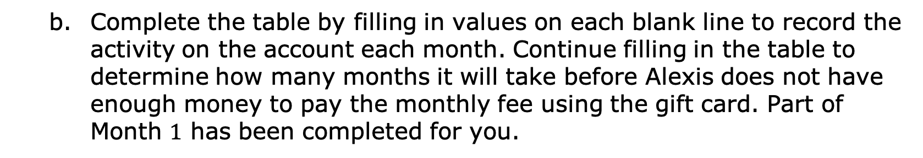
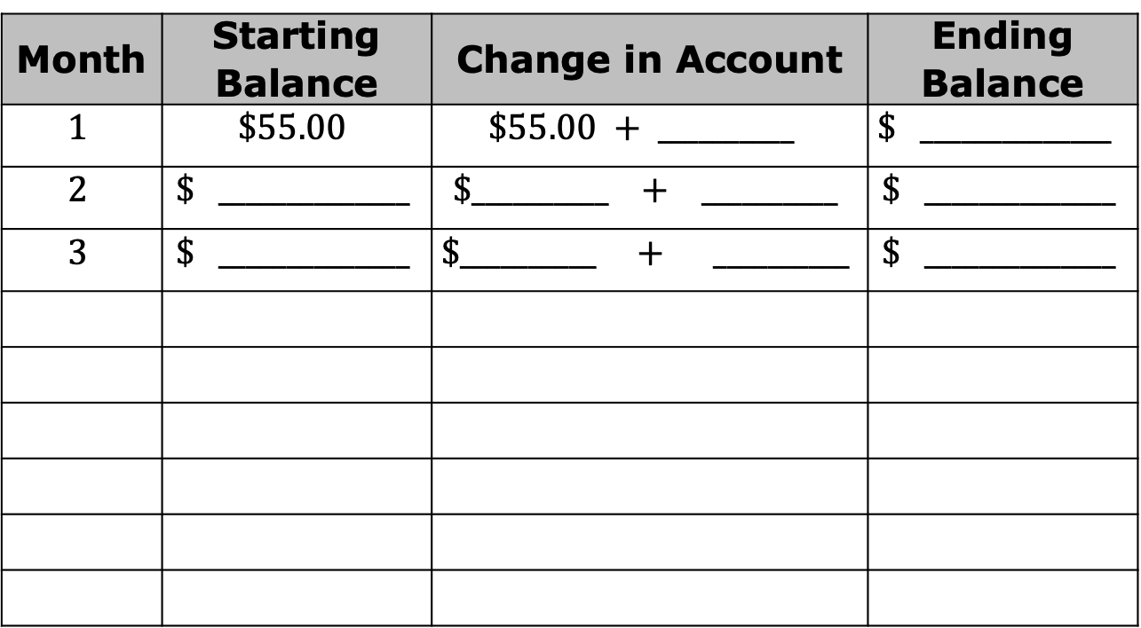
Complete the table by filling in values on each blank line to record the activity on the account each month. Continue filling in the table to determine how many months it will take before Alexis does not have enough money to pay the monthly fee using the gift card. Part of Month $1$ has been completed for you.
Month | Starting Balance | Change in Account | Ending Balance
$$1$$ | $$\$55.00$$ | $$\$55.00 + __________$$ | $$\$ ______________$$
$$2$$ | $$\$ ______________$$ | $$\$__________ + __________$$ | $$\$ ______________$$
$$3$$ | $$\$ ______________$$ | $$\$__________ + __________$$ | $$\$ ______________$$
volume 2, pg. 186

Slide 16
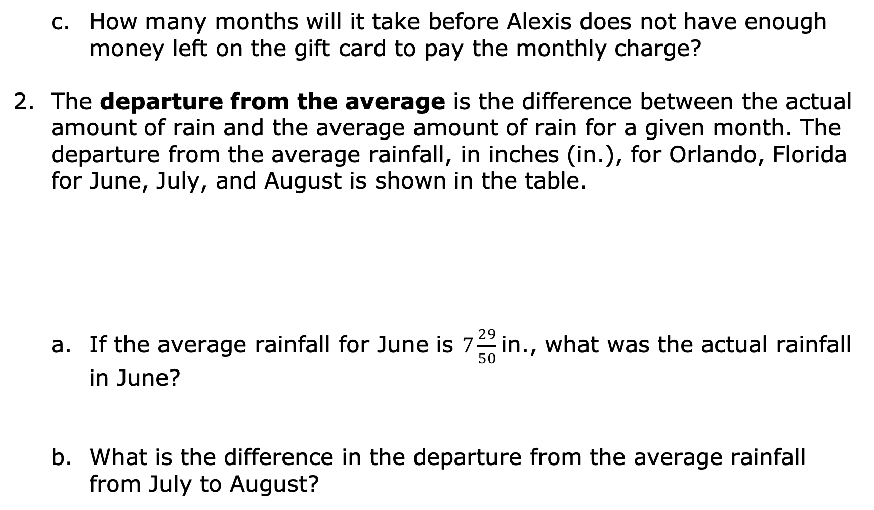
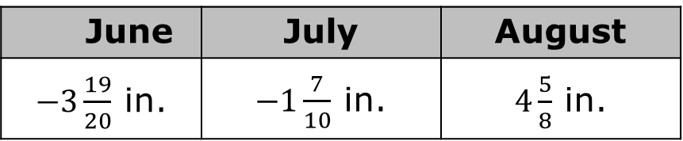
How many months will it take before Alexis does not have enough money left on the gift card to pay the monthly charge?
The departure from the average is the difference between the actual amount of rain and the average amount of rain for a given month. The departure from the average rainfall, in inches (in.), for Orlando, Florida for June, July, and August is shown in the table.
If the average rainfall for June is $7\frac{29}{50}$in., what was the actual rainfall in June?
What is the difference in the departure from the average rainfall from July to August?
June | July | August
$−3\frac{19}{20}$ in. | $−1\frac{7}{10}$ in. | $4\frac{5}{8}$ in.
volume 2, pg. 187

Slide 17
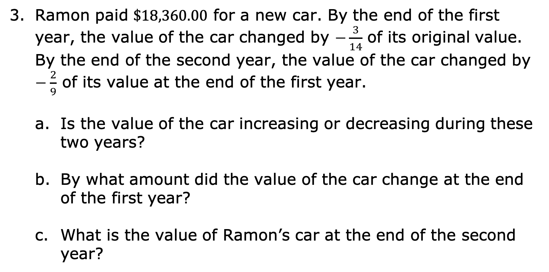
Ramon paid $\$18,360.00$ for a new car. By the end of the first year, the value of the car changed by $−\frac{3}{14}$ of its original value. By the end of the second year, the value of the car changed by $−\frac{2}{9}$ of its value at the end of the first year.
Is the value of the car increasing or decreasing during these two years?
By what amount did the value of the car change at the end of the first year?
What is the value of Ramon’s car at the end of the second year?
volume 2, pg. 187

Slide 18
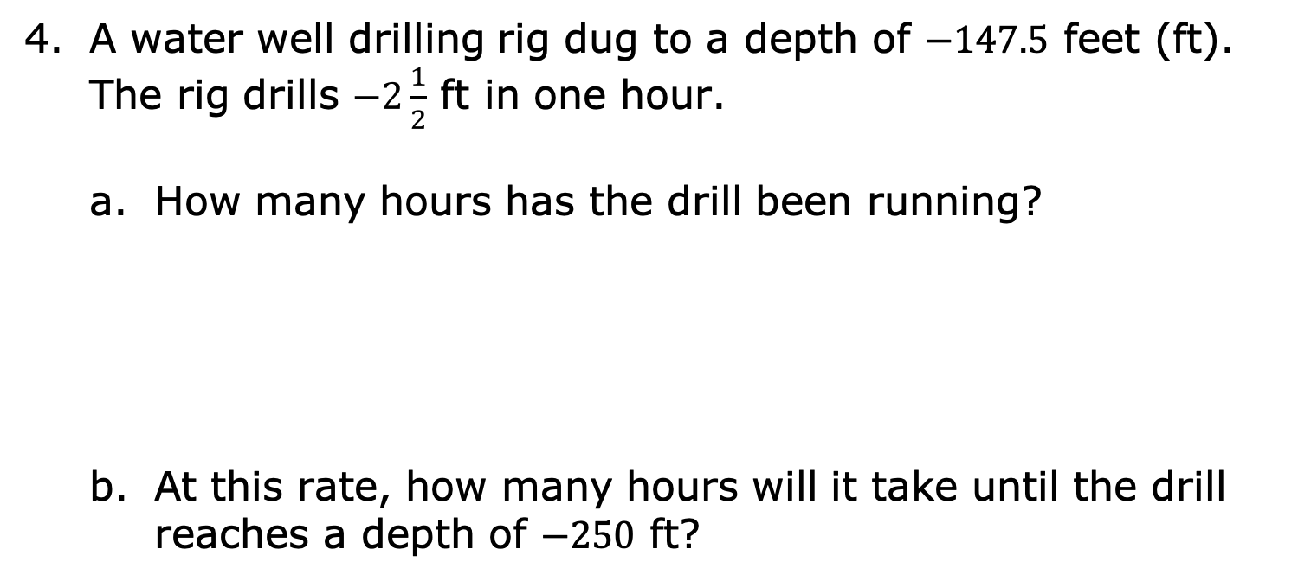
A water well drilling rig dug to a depth of $−147.5$ feet (ft). The rig drills $−2\frac{1}{2}$ ft in one hour.
How many hours has the drill been running?
At this rate, how many hours will it take until the drill reaches a depth of $−250$ ft?
volume 2, pg. 188

Slide 19

Your Turn
volume 2, pg. 188

Slide 20
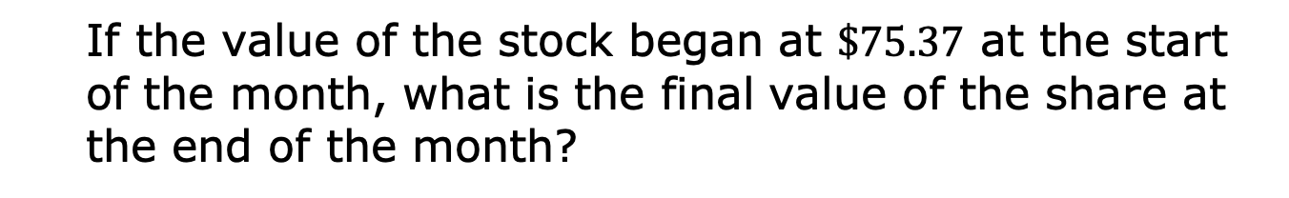
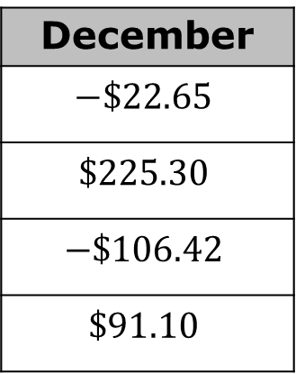
11.5.4 Your Turn!
The table shows the change in value for a share of stock in a company at the end of each week during the month of December. A negative value represents the amount the share decreased, and a positive value represents the amount the share increased.
December
$$−\$22.65$$
$$\$225.30$$
$$−\$106.42$$
$$\$91.10$$
If the value of the stock began at $\$75.37$ at the start of the month, what is the final value of the share at the end of the month?
volume 2, pg. 188

Slide 21
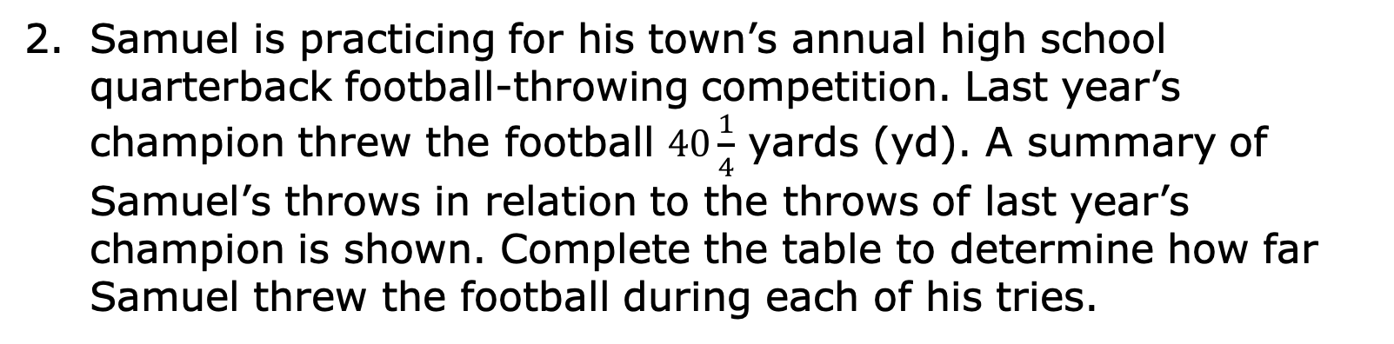
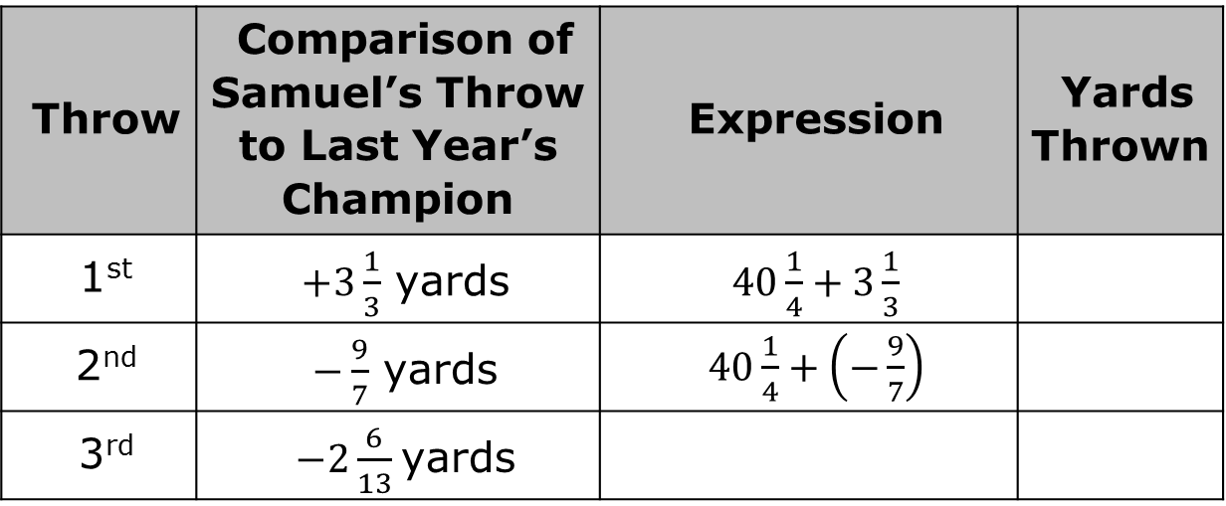
Samuel is practicing for his town’s annual high school quarterback football-throwing competition. Last year’s champion threw the football $40\frac{1}{4}$ yards (yd). A summary of Samuel’s throws in relation to the throws of last year’s champion is shown. Complete the table to determine how far Samuel threw the football during each of his tries.
Throw | Comparison of Samuel’s Throw to Last Year’s Champion | Expression | Yards Thrown
1st | $+3\frac{1}{3}$ yards | $40\frac{1}{4}+3\frac{1}{3}$
2nd | $−\frac{9}{7}$ yards | $40\frac{1}{4}+\left(−\frac{9}{7}\right)$
3rd | $−2\frac{6}{13}$yards
volume 2, pg. 188

Slide 22
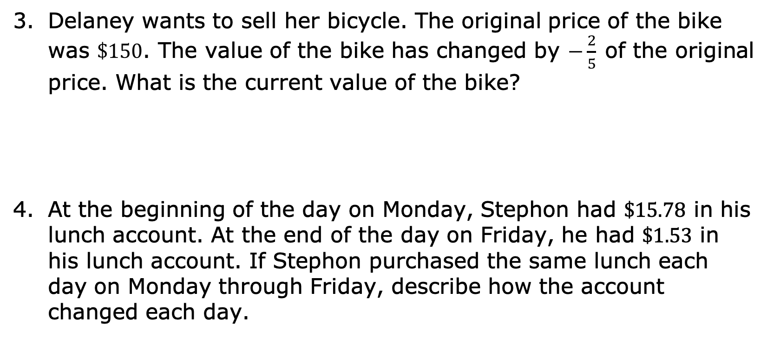
Delaney wants to sell her bicycle. The original price of the bike was $\$150$. The value of the bike has changed by $−\frac{2}{5}$of the original price. What is the current value of the bike?
At the beginning of the day on Monday, Stephon had $\$15.78$ in his lunch account. At the end of the day on Friday, he had $\$1.53$ in his lunch account. If Stephon purchased the same lunch each day on Monday through Friday, describe how the account changed each day.
volume 2, pg. 189

Slide 23

Wrap-Up
volume 2, pg. 189

Slide 24
11.5.5 Wrap-Up: Growth Mindset
As you reflect on today’s lesson, circle the word Sometimes, Always, or Never to indicate how often each statement describes you.
When I work hard on a problem, I expect that the answer will be correct. | Sometimes | Always | Never
There is no point in trying to do a problem if I know I won’t get the correct answer. | Sometimes | Always | Never
volume 2, pg. 189

Slide 25
Even if I made a mistake, I can still learn from working through a problem. | Sometimes | Always | Never
I can show that I understand how to solve a problem, even if there is an error in my work. | Sometimes | Always | Never
If my answers are incorrect even after working extremely hard, I still choose to work hard on the next problem. | Sometimes | Always | Never
volume 2, pg. 189

